Slide 1
Assessment Task 1 Feedback
22/2/2017

Slide 2
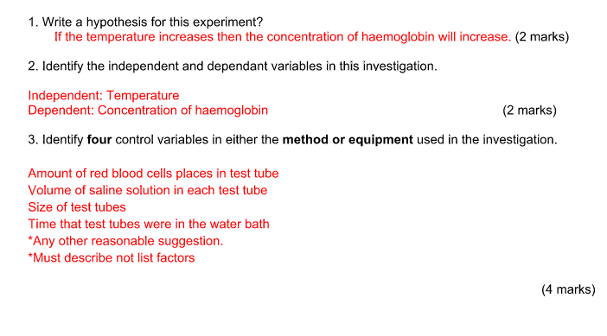

Slide 3
Notes
Included dependent/independent variable. Use if…when…
All did well
Most did well

Slide 4
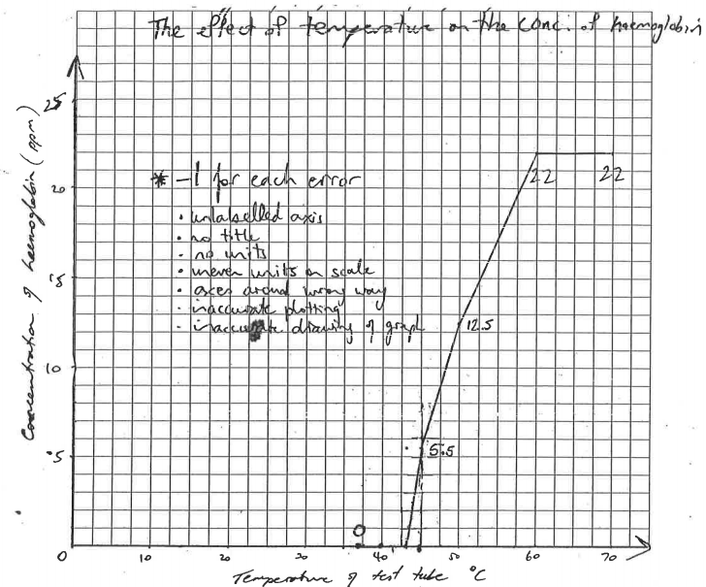
4.
(5marks)
-Descriptive title using independent/dependent variables
-Correct variables on axes
-Units
-Correct scale
-Correct plotting

Slide 5
Notes
For title, use the axis labels or independent/dependent variable
For the scales, to make life easier use 5, 10s or 2s.

Slide 6
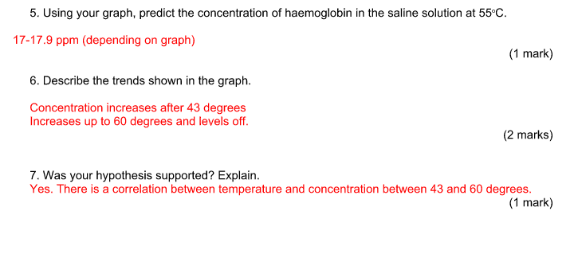
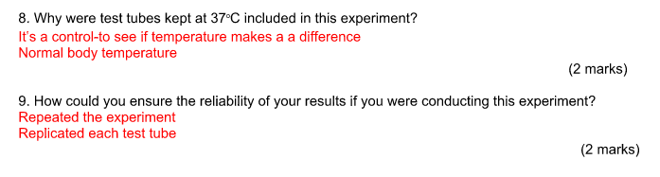

Slide 7
Notes
Most did well
Describe means say what you see. No need for explanation of data, just what is the data doing.
Explain how you know your hypothesis was supported. Question was a bit vague
Use of keywords- CONTROL
Use of keywords- REPEATS=doing the experiment more than once,. REPLICATE=having more than one flask/trial running at the same time

Slide 8
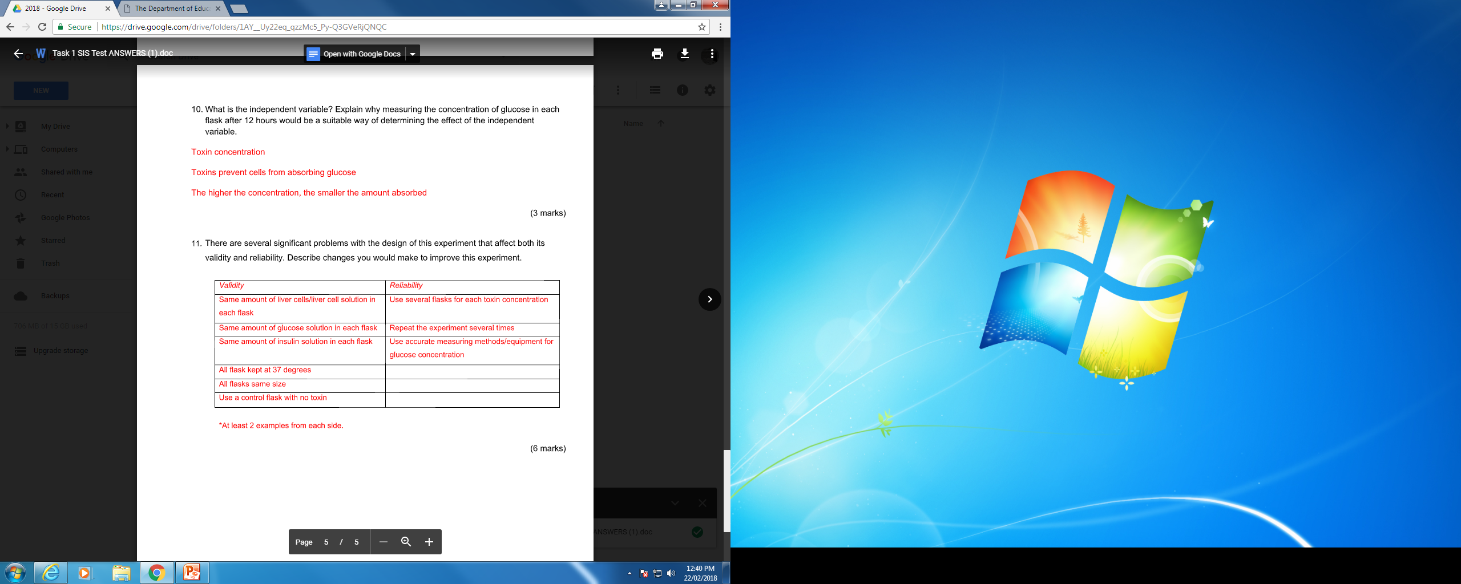

Slide 9
Notes
Use of the word concentration instead of amount (amount tends to be used for volume). Part two of question was a bit vague- Explain means how does the experiment relate to variable/hypothesis.
“Describe changes you would makes” –read question properly, don’t list problems. Also “affect both validity and reliability” so you need improvements for both to get full marks.

Slide 10
Complete these questions..

Slide 11
Model answer
The independent variable is the toxin concentration. The toxins prevents cells from absorbing glucose so the higher the concentration of toxin, the smaller the amount of glucose absorbed.

Slide 12
To improve the validity, I would make sure all the flasks were the same size and that they were all kept at 37 degrees. I would also ensure the amount of liver cells was the same in each flask and that there was the same amount of glucose solution in each flask. To improve reliability, I would repeat the experiment three times and have three flasks with the same concentration of toxins running the trial at the same time.

